Slide 1
Machine Learning
Year 13

Slide 2

Objectives
Students should be able to
State what is machine learning
Describe different types of machine learning
Compare types of machine learning
State the uses of different types of machine learning
Outline the process of Backpropagation

Slide 3
Types of AI
Artificial Intelligence is the ability of the computer to copy some aspect of human intelligence or the science of developing computers to think like human.
AI can be thought of as a machine with cognitive abilities such as problem solving and learning from examples. All of these can be measured against human benchmarks such as reasoning, speech and sight. AI is often split into three categories.

Slide 4
Types of AI
AI is often split into three categories.
Narrow/weak/ artificial narrow intelligence (ANI) Intelligence is when a machine has superior performance to a human when doing one specific task. It simulates human behaviour. Example Siri
General/Strong/Artificial General Intelligence (AGI) is when a machine is similar in its performance to a human in any intellectual task.
Super/artificial superintelligence (ASI) or superintelligence is when a machine has superior performance to a human in many tasks. This AI surpasses human intelligence and ability.

Slide 5
Machine learning
Keywords
Research.
Labelled Data
Unlabelled data
Defined and state how they are used in artificial intelligence

Slide 6
Machine learning
Machine learning is a subfield of artificial intelligence, in which computers/machines has the capability to imitate intelligent human behavior.
The algorithms are ‘trained’ and learn from their past experiences and examples.

Slide 7
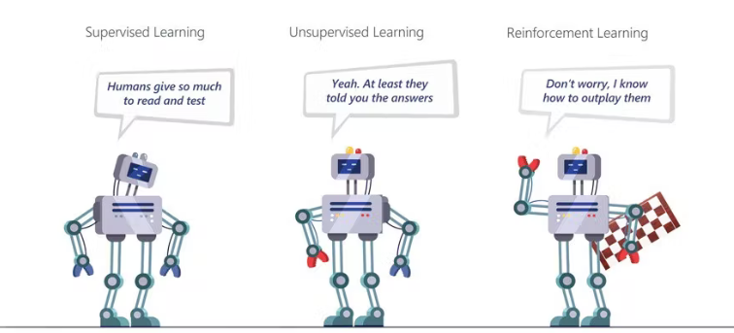
Types of machine learning
There are a number of different types of machine learning
supervised
unsupervised learning
reinforcement

Slide 8
Supervised learning
Supervised learning is a form of machine learning that uses an algorithm to identify patterns in data, then learn from these patterns.
The algorithm takes any number of inputs and outputs them into a set of predefined classes.
Supervised learning makes use of
regression analysis
classification analysis

Slide 9
What is regression analysis?
Regression is a statistical (mathematics) technique used to study the relationship between independent and dependent variables. In machine learning, use to predict a continuous outcome variable (y) based on the value of one or multiple predictor variables (x).
It predicts continuous/real values such as temperature, age, salary, price, etc.
​

Slide 10
What is classification analysis?
Classification is a process of organizing data into groups, or classes, based on similarities.
The groups are based on a set of predetermined criteria, and the data is classified according to which group it best fits into

Slide 11
How does it work?
The computer goes through a period of training.
During the training phase, the system is fed with labelled data sets, which instruct the system what outputs is related to each specific input value.
The trained model is then presented with input data. This is the data that has been labelled, but the labelled has not been revealed to the algorithm.
The aim of the testing data is to measured how accurate the algorithm will perform on unlabeled data

Slide 12
Unsupervised learning
Unsupervised learning is a type of machine learning in which models are trained using unlabeled dataset and are allowed to act on that data without any supervision
The model itself find the hidden patterns and insights from the given data.
It can be compared to learning which takes place in the human brain while learning new things.
Unsupervised machine learning is further categorized into two types:
Clustering
Association

Slide 13
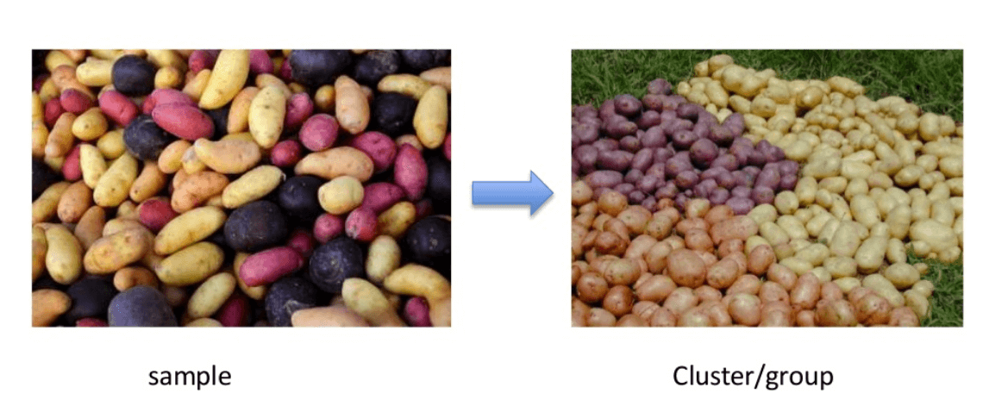
What is Clustering?
Clustering is the process of dividing uncategorized data into similar groups or clusters.
This process ensures that similar data points are identified and grouped.
Clustering algorithms is key in the processing of data and identification of groups (natural clusters)

Slide 14
Why Clustering is important
Attributes of unique entities can be profiled easier. This can subsequently enable users to sort data and analyze specific groups.
Enables businesses to approach customer segments differently based on their attributes and similarities. This helps in maximizing profits.
It can help in dimensionality reduction if the dataset is comprised of too many variables. Irrelevant clusters can be identified easier and removed from the dataset

Slide 15
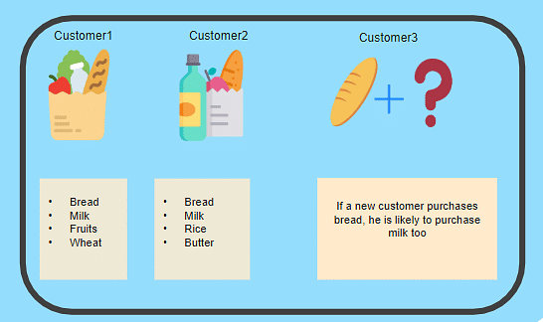
What is Association?
This unsupervised learning method finds relationships between the variables in a large dataset.
It determines the set of items that occurs together in the dataset. Association rule makes marketing strategy more effective
A typical example of Association rule is Market Basket Analysis.

Slide 16
Advantages/Disadvantage of Unsupervised Learning
advantages
Disadvantages
Used for more complex tasks there is no labeled input data.
Preferable as it is easy to get unlabeled data in comparison to labeled data.
It is more difficult to learn because it does not have corresponding output.
The result might be less accurate as input data is not labeled
algorithms do not know the exact output in advance.

Slide 17
Comparison
Supervised Learning | Unsupervised Learning
trained using labeled data. | trained using unlabeled data.
takes direct feedback to check if it is predicting correct output or not. | does not take any feedback.
predicts the output. | finds the hidden patterns in data.
input data is provided to the model along with the output. | only input data is provided to the model.
train the model so that it can predict the output when it is given new data. | It finds the hidden patterns and useful insights from the unknown dataset.
needs supervision to train the model. | does not need any supervision to train the model.
Categorized into Classification and regression problems | Cateogorized into Clustering and association problems
the input is known as well as corresponding outputs. | used for those cases where we have only input data and no corresponding output data.
produces an accurate result. | may give less accurate result
is not close to true Artificial intelligence as in this, we first train the model for each data, and then only it can predict the correct output. | closer to the true Artificial Intelligence as it learns similarly as a child learns daily routine things by his experiences.
It includes various algorithms such as Linear Regression, Logistic Regression, Support Vector Machine, Multi-class Classification, Decision tree, Bayesian Logic, etc. | It includes various algorithms such as Clustering, KNN, and Apriori algorithm.

Slide 18
Reinforcement learning
Machine Learning

Slide 19
Reinforcement learning
"Reinforcement learning is a type of machine learning method where an intelligent agent (computer program) interacts with the environment and learns to act within that."
It is a feedback-based
A machine learns to behave in an environment by performing the actions and seeing the results of actions.
For each good action, the agent gets positive feedback
For each bad action, the agent gets negative feedback or penalty.

Slide 20
Characteristics
The agent learns automatically using feedbacks without any labeled data
Solves a specific type of problem where decision making is sequential, and the goal is long-term.
The agent interacts with the environment and explores it by itself.
The primary goal of an agent is to improve the performance by getting the maximum positive rewards.
The agent learns with the process of trial and error, and based on the experience, it learns to perform the task in a better way.
There is no to pre-program the agent, as it learns from its own experience without any human intervention.

Slide 21
Semi-supervised (active) learning
Semi-supervised learning makes use of labelled and unlabeled data to train algorithms that can interactively query the source data and produce a desired output.
A small amount of labelled data is used combined with large amounts of unlabeled data.
Examples
Classification of web pages into sport, science, leisure, finance, and so on.
A web crawler is used to look at large amounts of unlabeled web pages, manually annotating (labelling) them.

Slide 22
Artificial Neural Network

Slide 23
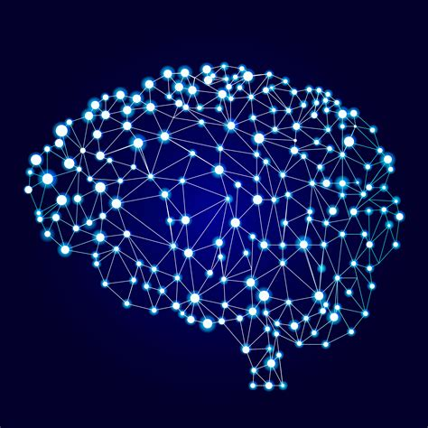
Artificial neural network
An Artificial Neural Network in the field of Artificial intelligence is where the computer attempts to mimic the network of neurons makes up a human brain so that computers will have an option to understand things and make decisions in a human-like manner.

Slide 24
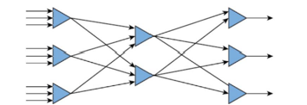
Artificial neural network
An artificial neural network could be created in software or hardware.
The triangles are the nodes in the network which represent artificial neurons. (Sometimes these are represented as circles).
In general, a node can receive one or more inputs and can provide an output to one or more of the other nodes.
The modelling of the action of the node involves applying a weighting factor to each input.
The weighted input values are summed and then an activation function is used to compute a value for the output of the node.
If the input is not a numerical value it must be converted to one so that the weighted values can be summed.

Slide 25
SUMMARY Artificial Neural Network
Consist of input, output and hidden layers.
Each connection between nodes represents a potential pathway for information to flow through the network.
Each node takes in inputs from the connections and applies an activation function to determine whether it will pass on its own output to the connected nodes in the next layer.
This process continues until the output is produced at the end of the network.
Error values are calculated based on how closely the output matches what was expected.
These errors are then propagated backward through the network, adjusting the strengths of each connection in an attempt to minimize overall error.
This process can be repeated for multiple training examples.

Slide 26
Example of an ANN
An example of an AI system using an artificial neural network is one which estimates the cost-effectiveness of batteries based on
the initial price paid
lifetime of use.
Each input node would represent one example of a battery.
The inputs would be specific data hat identified the battery and the price.
One of the nodes in the hidden layer could be concerned with the type of device the battery was to be used in.
The other node in the hidden layer could relate to the type of user of the device.
Each node in the output layer would compute an estimated value for the cost per unit of time for a specific battery

Slide 27
Deep Learning
Artificial Neural Network

Slide 28
Deep learning
Deep learning networks are neural networks with many layers such as input layers, output layer and hidden layer.
It is based on the interconnection between neurons in the human brain. The system is able to think like a human using neural network and its performance improves with more data.
The layered network can process extensive amounts of data and determine the “weight” of each link in the network
Example, in an image recognition system, some layers of the neural network might detect individual features of a face, like eyes, nose, or mouth, while another layer would be able to tell whether those features appear in a way that indicates a face.

Slide 29
Deep learning
The main layers in Deep Learning
The input layer accepts input data;
output layers show the expected results
hidden layers are used to find any hidden pattern and feature from the data. This is where data from the input layer is processed into something which can be sent to the output layer

Slide 30
How does deep learning work?
Calculate the weighted sum
Use this weighted sum in 1 as input for the activation function.
The activation function adds bias and decides whether the neuron should be triggered or not.
Predict output at the output layer.
Compare predicted output and actual output
Use the backpropagation method for improving the performance of the model. In this step, the cost function plays a vital role in reducing the error rate.

Slide 31
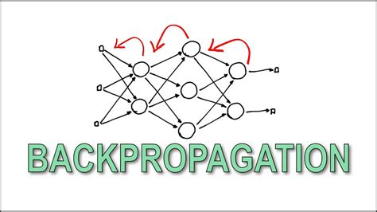
Deep Learning- Backpropagation
Deep Learning makes use of Backpropagation
Backpropagation in neural network is a short form for “backward propagation of errors.”
It is a standard method of training artificial neural networks.
This method helps calculate the gradient of a loss function with respect to all the weights in the network

Slide 32
Deep learning
Back Propagation when designing neural networks, it is necessary to give random weightings to each of the neural connections.
However, the system designer will not initially know which weight factors to use to produce the best results. It is necessary to train the neural networks during the development stage
The training program is iterative; the outputs produced from the system are compared to the expected results and any differences in the two values/results are calculated.
These errors are propagated (feedback) back into the neural network in order to update the initial network weightings.
This process (training) is repeated until the desired outputs are eventually obtained, or the errors in the outputs

Slide 33
Deep Learning- Backpropagation
Regression Machine learning builds heavily on statistics; for example, regression is one way of analyzing data before it is input into a system or model.
Regression is used to make predictions from given data by learning some relationship between the input and the output.
It helps in the understanding of how the value of a dependent variable changes when the values of independent variables are also changed.
This makes it a valuable tool in prediction applications, such as weather forecasting. In machine learning, this is used to predict the outcome of an event based on any relationship between variables obtained from input data and the hidden parameters

Slide 34

Watch the video and make salient notes

Slide 35
THANK YOU
@Jenny.com

